Slide 1
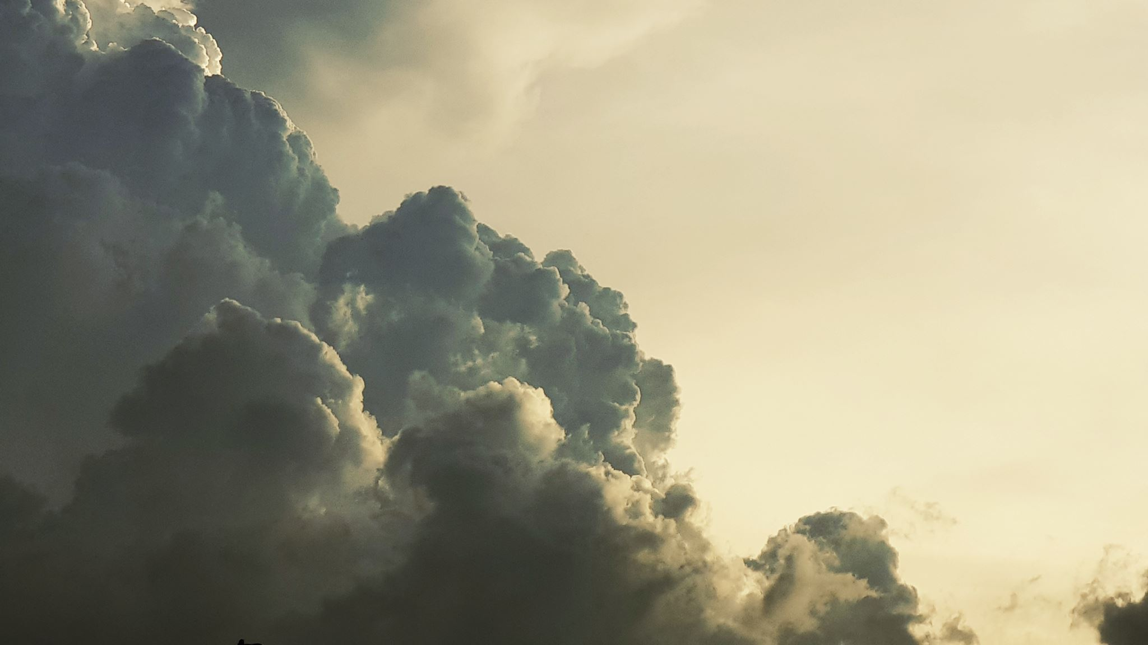
OUR REAL HOME IS HEAVEN
(but God sends us glimpses)

Slide 2
2nd Sunday of Lent
Lent: a time of preparation for our ultimate journey

Slide 3
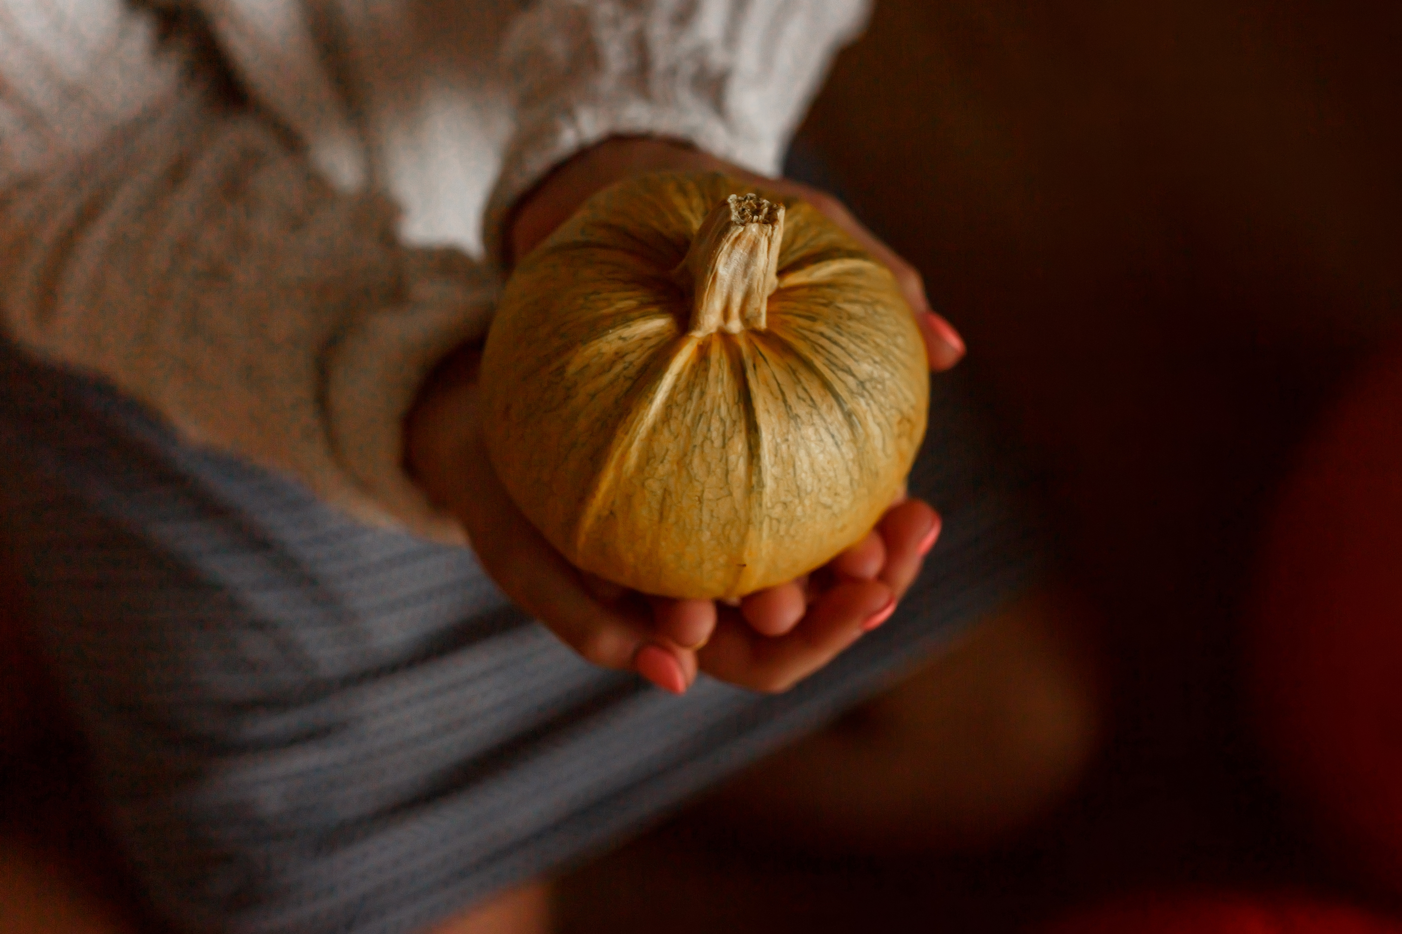
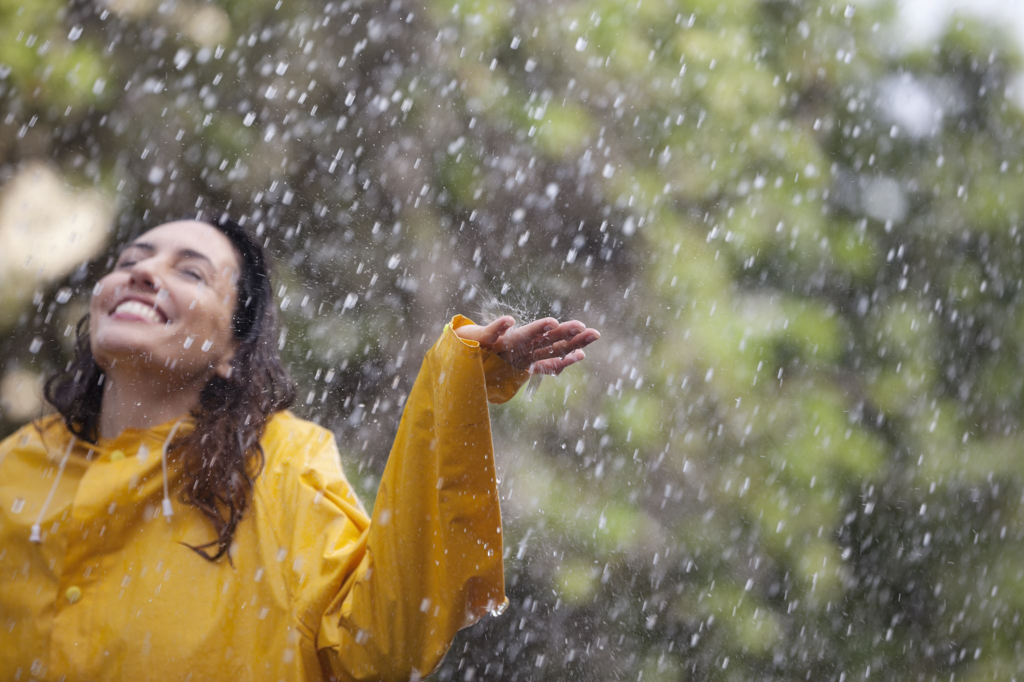
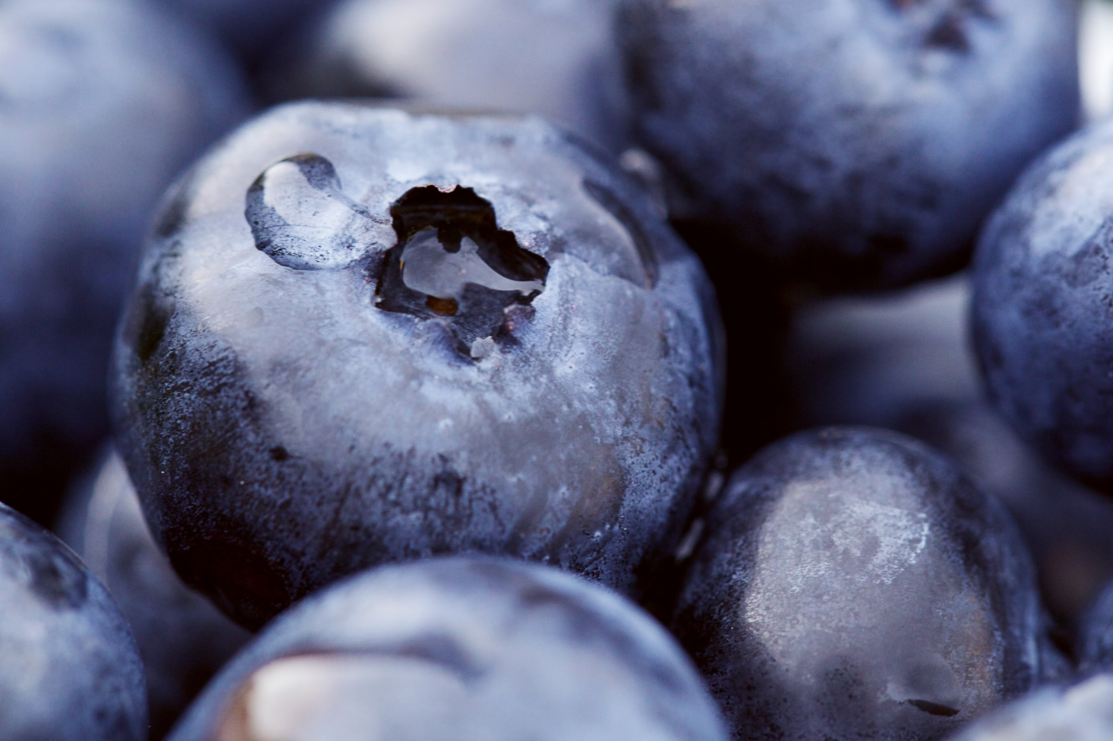
We DO get daily glimpses of Heaven…

Slide 4
…but we have to pay attention…

Slide 5
THROUGHOUT HISTORY…
Dreams…
Visions…
Trances…

Slide 6
2nd Sunday of Lent
Reading 1: Gn 15:5-12, 17-18
Gospel: Luke 9:28-36

Slide 8
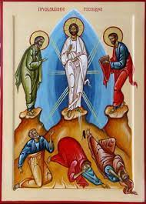

Slide 9
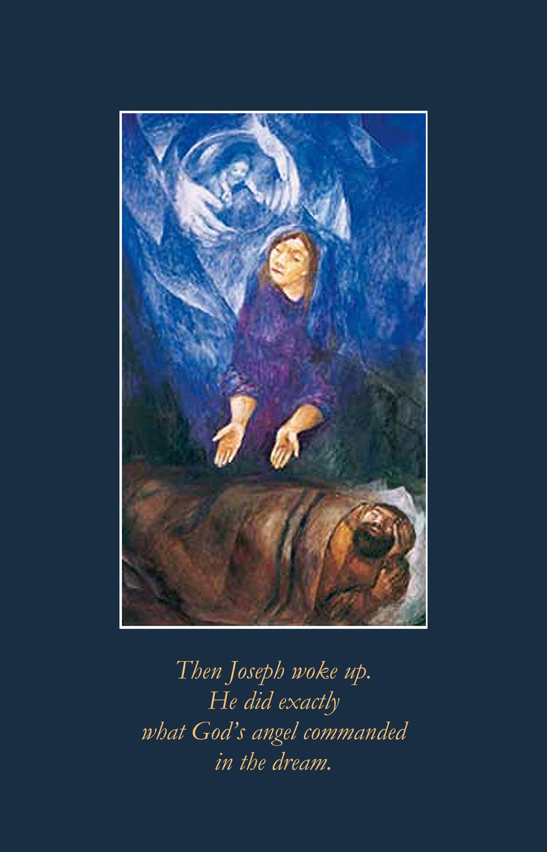
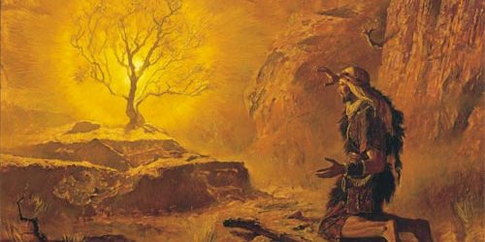
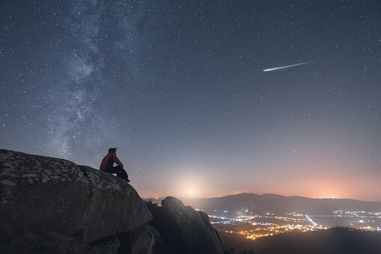
POWER OF DREAMS…

Slide 10
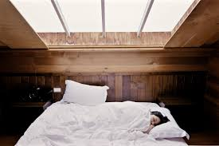
THEN…
NOW…

Slide 11
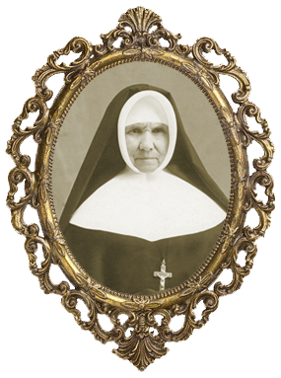
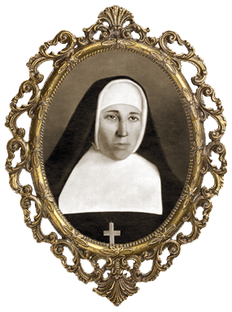
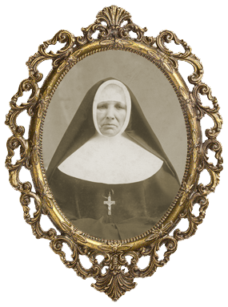
WHAT IF………

Slide 12
2021 CHAPTER VISION:

Slide 13
Sister Carmen Lucia dos Santos
Brazil
Sister Gail Mayotte USA
Sister Suzanne Carriere Ontario
Sister Monique Lefebvre North Bay, Ontario

Slide 14
“You shall bear a son…”

Slide 15
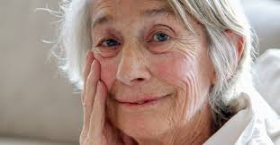

Slide 16
Glimpses of heaven… Visions of what awaits us… Angels of kindness…

Slide 17
A DREAM ABOUT ERNEST…

Slide 18
Right here and now …

Slide 19
Faith sharing question: Share a dream you’ve had recently or in the past that actually revealed something powerful to you? OR Tell us why you believe in dreams and visions.

