Slide 1
Living Soulfully
Abundance From a Provident God:
2 Kings 4:42-44 The Message
One day a man arrived from Baal Shalishah. He brought the man of God twenty loaves of fresh-baked bread from the early harvest, along with a few apples from the orchard.
Elisha said, “Pass it around to the people to eat.”
His servant said, “For a hundred men? There’s not nearly enough!”
Elisha said, “Just go ahead and do it. God says there’s plenty.”
And sure enough, there was. He passed around what he had—they not only ate, but had leftovers.

Slide 2
A SILENT WALK IN God’s abundance…
https://www.yout-ube.com/watch?v=MbGQJ6Zys6Y

Slide 3
Trust God’s Love

Slide 4
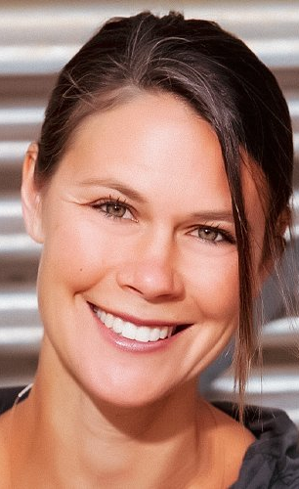
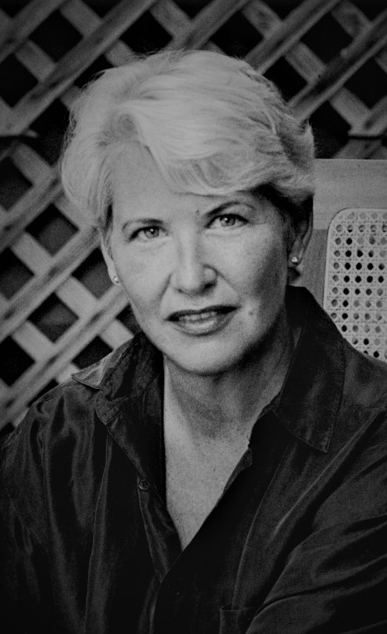
What do the wise ones say????

Slide 5
ALL AROUND ME…

Slide 6
IT ONLY TAKES A SECOND…
Unscheduled No matter the day is already planned to the minute. No matter how pressing the deadline, the must do, the should. It takes only a second to look out the window and see the brown bunny in the brown grass. It takes only a second to fall in love with the twitchy nose, the nervous eyes, the lumpy shape of bunny. How quickly the known world cants toward awe when wonder slips in—wonder forged not from epiphany or greatness but from the barest instant of meeting what is real.
~~Rosemerry Wahtola Trommer

Slide 7
Everything is incredible…
“Our goal should be to live life in radical amazement...to get up in the morning and look around at the world in a way that takes nothing for granted. Everything is phenomenal. Everything is incredible. To be spiritual is to be amazed." ~Rabbi Abraham Joshua Heschel

Slide 8
… “to be spiritual is to be amazed…”

Slide 9
“in the chapel of eggs…” Anne Sexton
Welcome Morning There is joy In all: In the hair I brush each morning, In the Cannon towel, newly washed, That I rub my body with each morning, In the chapel of eggs I cook Each morning, In the outcry from the kettle that heats my coffee Each morning, In the spoon and the chair That cry “hello there, Anne” Each morning, In the godhead of the table That I set my silver, plate, cup upon Each morning. All this is God, Right here in my pea-green house Each morning And I mean, Though often forget, To give thanks, To faint down by the kitchen table In a prayer of rejoicing As the holy birds at the kitchen window Peck into their marriage of seeds. So while I think of it, Let me paint a thank-you on my palm For this God, this laughter of the morning, Lest it go unspoken. The Joy that isn’t shared, I’ve heard, dies young. —Anne Sexton

Slide 10
“walk slowly…bow often…”
Mary Oliver
When I am among the trees, especially the willows and the honey locust, equally the beech, the oaks and the pines, they give off such hints of gladness. I would almost say that they save me, and daily.
I am so distant from the hope of myself, in which I have goodness, and discernment, and never hurry through the world but walk slowly, and bow often.
Around me the trees stir in their leaves and call out, “Stay awhile.” The light flows from their branches.
And they call again, “It’s simple,” they say, “and you too have come into the world to do this, to go easy, to be filled with light, and to shine.”

Slide 11
“notice each thing so each thing gets noticed…”
“We are here to witness the creation and abet it. We are here to notice each thing so each thing gets noticed. Together we notice not only each mountain shadow and each stone on the beach but, especially, we notice the beautiful faces and complex natures of each other. We are here to bring to consciousness the beauty and power that are around us and to praise the people who are here with us. We witness our generation and our times. We watch the weather. Otherwise, creation would be playing to an empty house.”

Slide 12
Let’s take a few minutes…

Slide 13
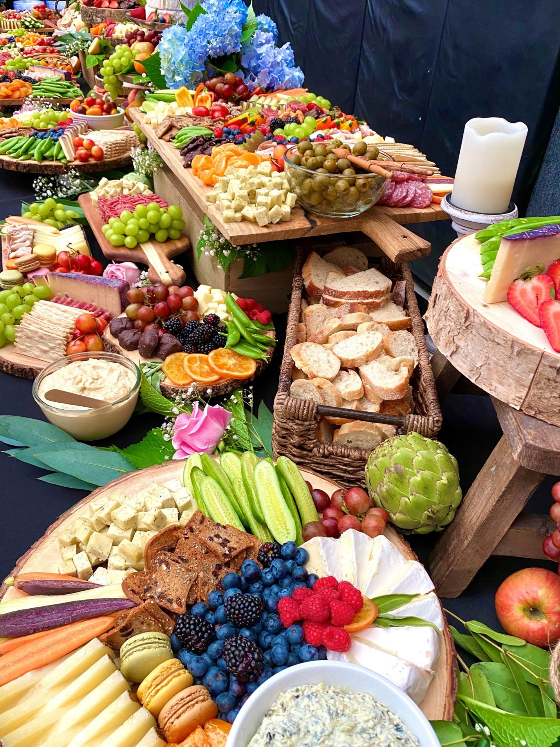
Friday Evening Prayer
https://youtu.be/llWJPzYFCYs
“Heaven sings with gladness…earth sings out rejoicing…Jesus Christ is risen from the dead…”

Slide 14
GOD MADE US HOPING WE’D ENJOY IT!!!
I look up at your macro-skies, dark and enormous, your handmade sky-jewelry, Moon and stars mounted in their settings.
Then I look at my micro-self and wonder, Why do you bother with us? Why take a second look our way?
Yet we've so narrowly missed being gods, bright with Eden's dawn light.
You put us in charge of your handcrafted world, repeated to us your Genesis-charge,
Made us lords of sheep and cattle, even animals out in the wild,
Birds flying and fish swimming, whales singing in the ocean deeps.
God, brilliant Lord, your name echoes around the world. Psalm 8: 3-9

Slide 15
ENTERING REST… from BEING HOME by Gunilla Norris

